Slide 1
Context Diagrams – Revisited
Starting an Analysis from a Narrative.
Important Note:
Model the narrative as accurately as possible, ensuring that you have identified multiple scenarios, where warranted.
Ensure that you address Composite Data Flows as you model, and make note of them.
Do the same thing for your assignments, term tests, and final exam.

Slide 2
Minicase 1. – Modeled after Page 358 Course Text:
Given the following narrative description, draw a context diagram for the portion of the activities described.
The purpose of the Textbook Inventory System at a campus bookstore is to supply textbooks to students for classes at a local college. The college’s academic departments submit initial data about courses, instructors, textbooks, and projected enrollments to the bookstore on a Textbook Master List. The bookstore generates a Purchase Order, which is sent to publishing companies supplying textbooks. Book orders arrive at the bookstore accompanied by a Packing Slip, which is checked and verified by the receiving department. Students fill out a Book Request that includes course information. When they pay for their books, the students are given a Sales Receipt.

Slide 3

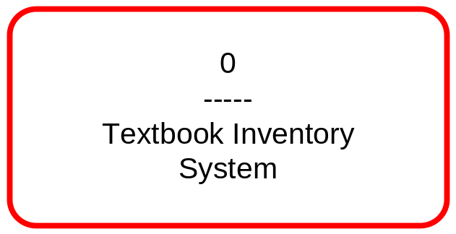
Step One – Identify the System, and Draw the Context Diagram
So, the system is inside the campus bookstore.
Now, determine from the narrative WHAT the system sends/provides to whom, and WHAT the system receives from whom in the context of the scope of this system in order to solve the problem at this level of abstraction.

Slide 4
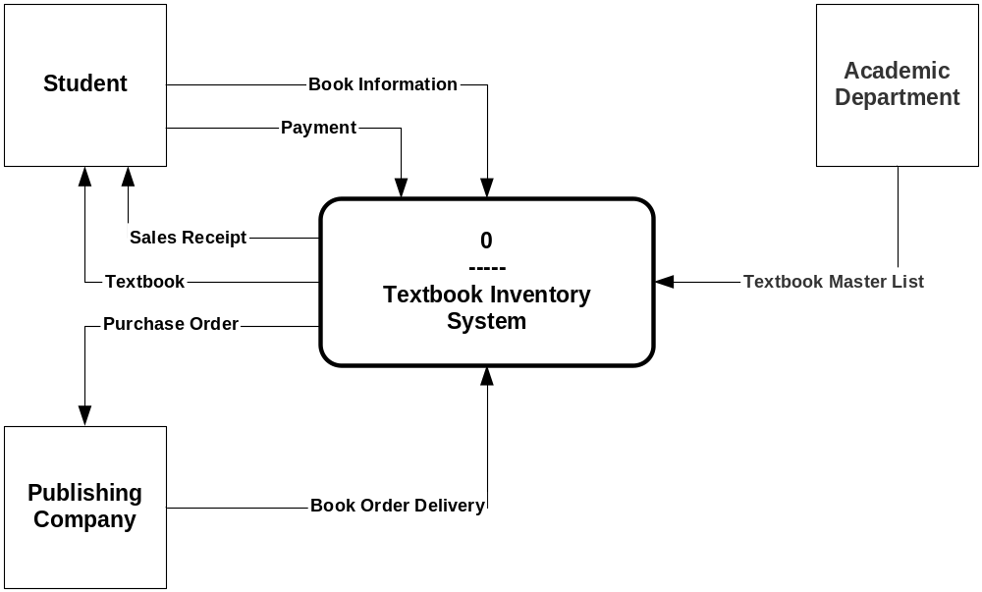
Textbook Inventory System

Slide 5
Step Three – Identify Potential Use Cases…
Scenario 1:
The system supplies a Textbook to a Student.
Scenario 1:
The system supplies a Textbook to a Student.
Scenario 2:
The system receives a Textbook Master List from an Academic Department.
Scenario 3:
The system sends a Purchase Order to a Publishing Company.
You must determine if it makes sense to have a use case for each scenario, or combine scenarios to form one use case.
Note that none of the above scenarios would be combined together. Why is this statement true?
Notes:
Three separate entities provides the first hint…
These are not homogeneous activities. Rather, they are all separate activities totally separate from each other.

Slide 6
Potential Use Cases continued…
Scenario 4:
The system receives a Book Order Delivery from a Publishing Company.
Book Order Delivery = Book Order + Packing Slip.
Scenario 5:
The system receives Book Information from a Student.
Book Information = Book Name + Course Information
Scenario 6:
The system receives a Payment from a Student.
Scenario 7:
The system supplies a Sales Receipt to a Student.

Slide 7
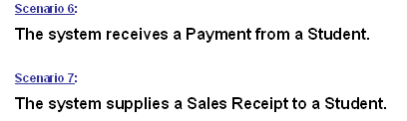
As previously stated, each scenario must be evaluated to determine if it warrants its own use case or should be combined with others scenarios to form a more cohesive use case.
Thus, you must STOP and THINK, and not blindly create use cases merely as an academic exercise; otherwise your analysis will severely lack quality, and your credibility as an analyst in industry will also suffer.
Would these two scenarios be combined into one use case? Why/why not?

Slide 8
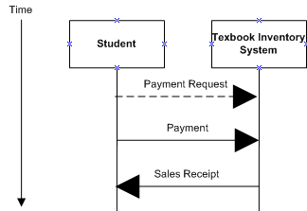
One Possible TSD
Note the Trigger Event – Payment Request. You must have an event to initialize the flow of data.

Slide 9

These three scenarios might also be combined into one use case?

Slide 10
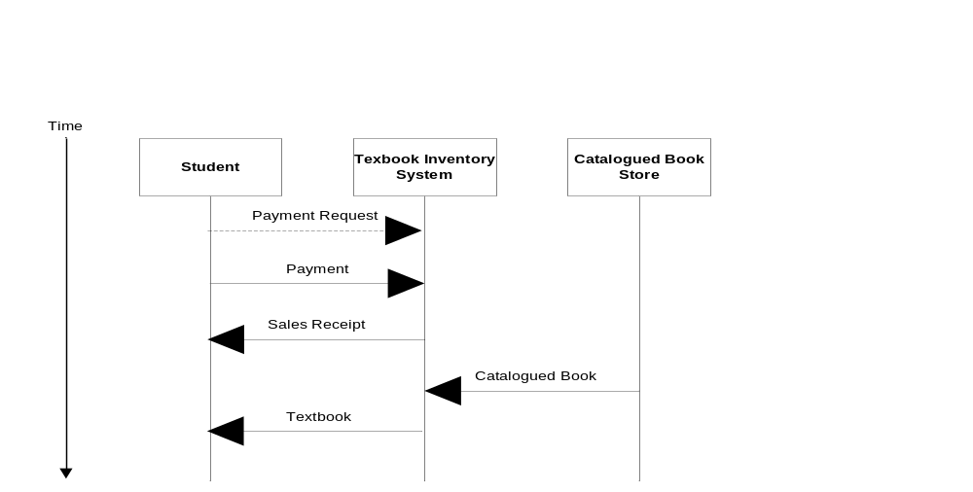
Another Possible TSD
Note the Trigger Event – Payment Request. You must have an event to initialize the flow of data.

Slide 11
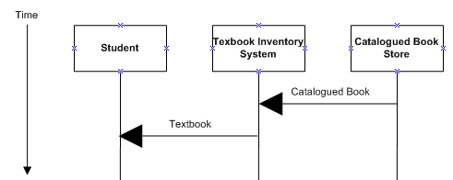
Examples of Invalid Use Case – Scenario is Modeled in Isolation
A Student cannot MAGICALLY receive a Textbook from the system! At a minimum, there is a missing Event and Data Flow – i. e. Textbook Request, and Sales Receipt, should occur before any other flows.

Slide 12
Conclusions – Important to Note!
From a narrative description that describes the physical process, we can create logical models:
  a context diagram
  a set of potential use-cases
  which in turn lead into the development of other analysis models.
From a narrative description that describes the physical process, we can also create, if necessary:
  a set of potential functional requirements for the Statement of Scope contract.

Slide 13
Potential Functional Requirements
The system shall supply a Textbook to a Student.
The system shall receive a Textbook Master List from an Academic Department.
The system shall send a Purchase Order to a Publishing Company.

Slide 14
Potential Functional Requirements continued…
The system shall receive a Book Order Delivery from a Publishing Company, where a Book Order Delivery is defined as a Book Order and a Packing Slip.
The system shall receive Book Information from a Student, where Book Information is defined as a Book Name and Course Information
The system shall receive a Payment from a Student.
The system shall supply a Sales Receipt to a Student.

Slide 15
Step Four –Moving From The Context Diagram to a Level One DFD

Slide 16
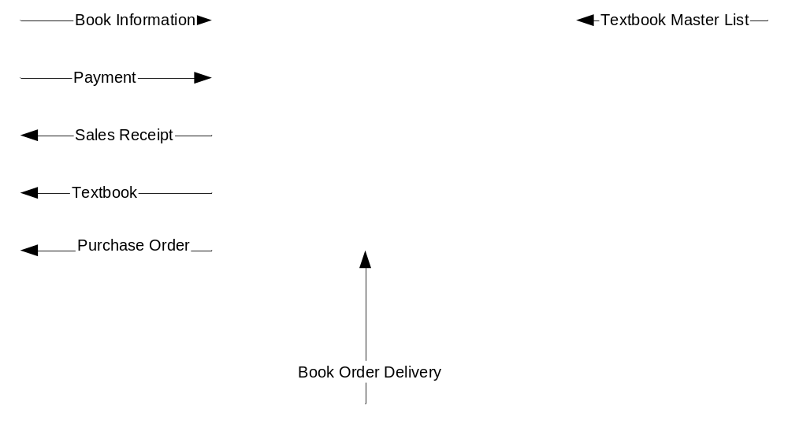
Moving On To A Level One DFD – Balancing

Slide 17
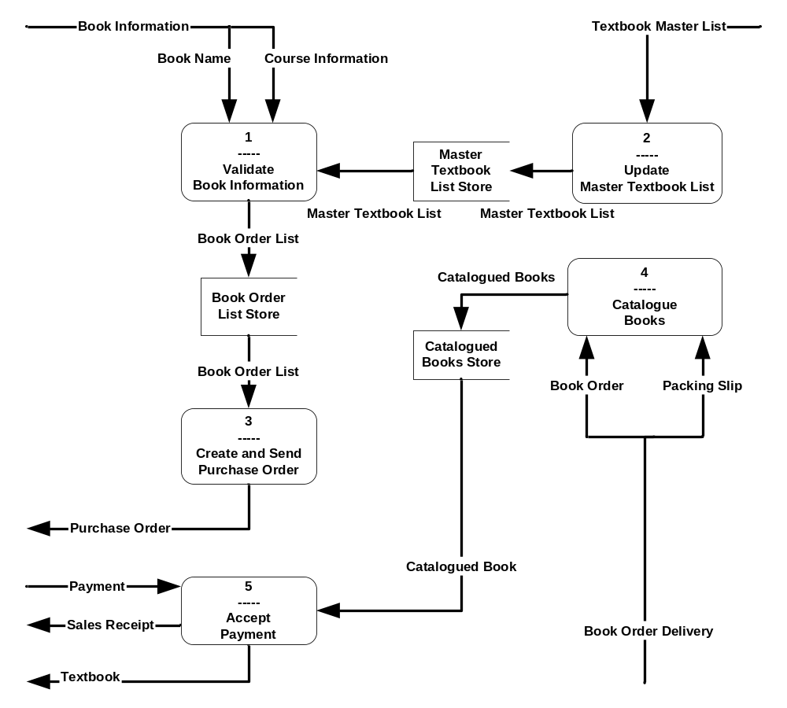
Textbook Inventory System –The Level One DFD

Slide 18
What’s Left To Do?
Ensure that your project plan (Gantt chart) accurately reflects what you planned and what actually occurred during the project (they are seldom the same).
Ensure that you have maintained an accurate Data Dictionary all along.
Identify processes that are not atomic, and create Level 2 .. n DFDs. Create the narratives that go along with the DFDs.
Create Use Case Narratives and Time Sequence Diagrams.
Create Analysis Entity-Relationship Diagrams, and their narratives.
Identity missing Business Rules – here are some examples:
  Can a student pay for the Textbook before he/she receives it?
  How does the system “know” that this particular student has ordered a particular Textbook? Does the system have to know that?
  Can a student cancel a book request? If so, what happens in this case?
  How does the system “know” that the books and their quantity ordered in the Purchase Order has actually been delivered in the Book Delivery?
  How does the student know if the Textbook is currently in stock?
Conduct frequent Technical Reviews as you go along – at least once a week for your assignments and/or projects is recommended.

